Slide 1
Comparation of YesWorkflow and ‘Strcode’ R extension
based on a simple user-case: iris data-set
Xiaoliang Jiang

Slide 2
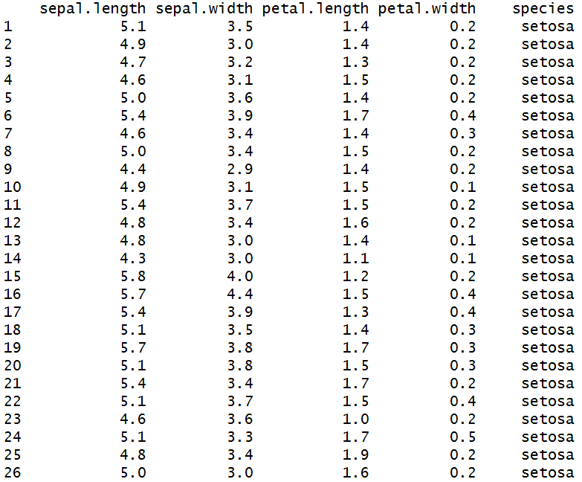
Introduction to IRIS data-set
The data set consists of 50 samples
from each of three species of Iris: Iris setosa, Iris virginica and Iris versicolor
Four features were measured from each sample: the length and the width of the sepals and petals, in centimetres.
The example is about extract two different sub-dataset from iris, and identify whether they are identical

Slide 3
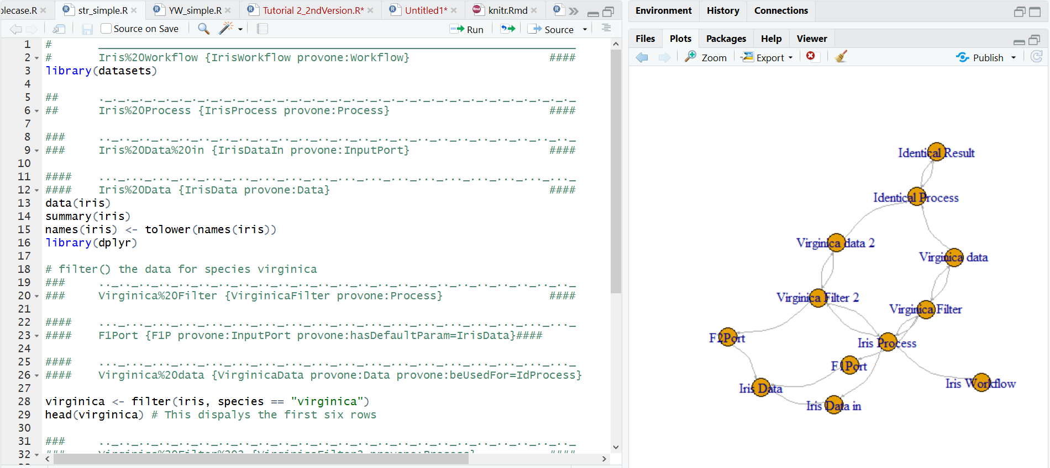
Overview of ‘Strcode’ R extension

Slide 4
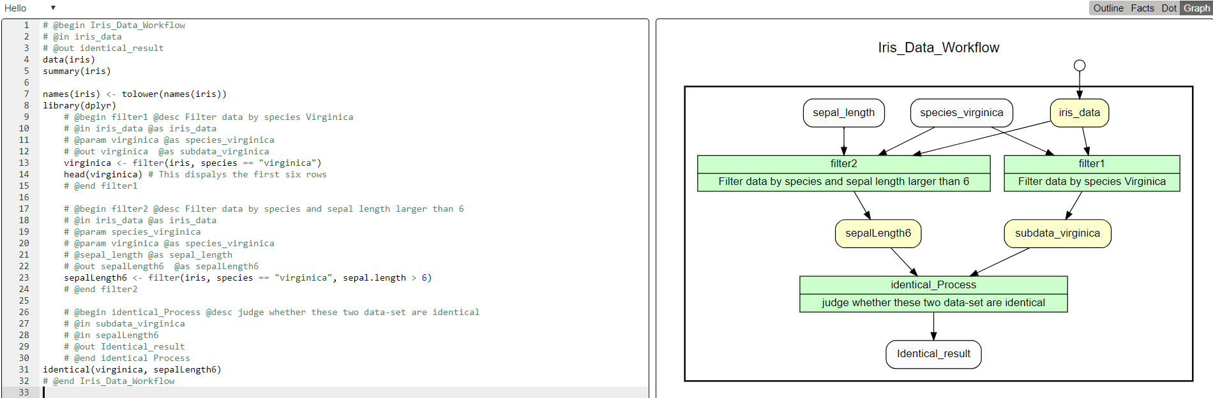
Overview of YesWorkflow

Slide 5
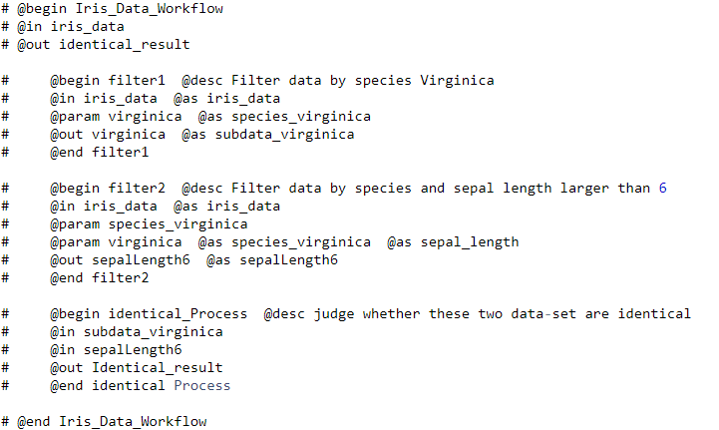
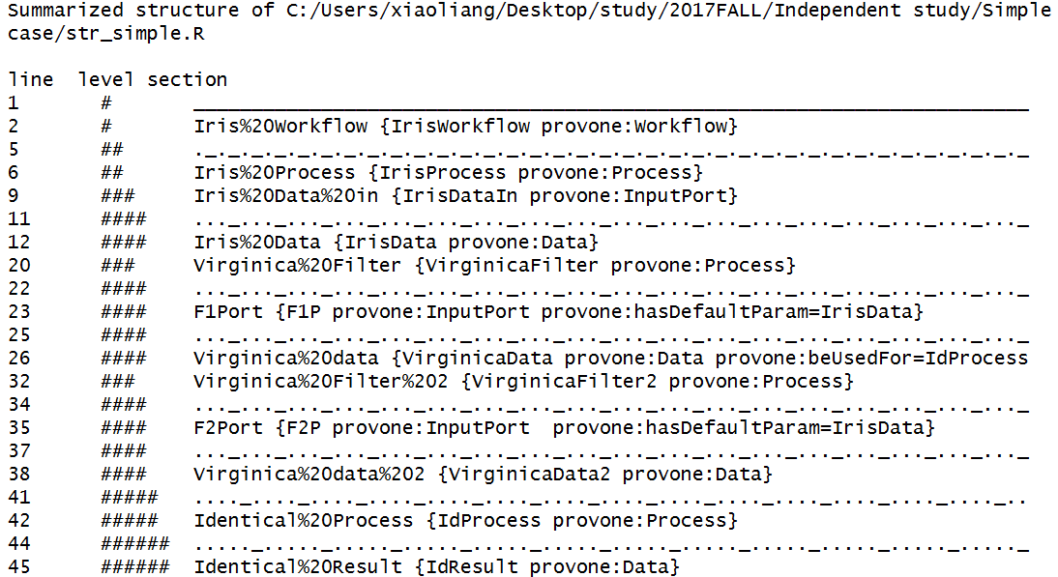
Similarity: Summary Outline

Slide 6
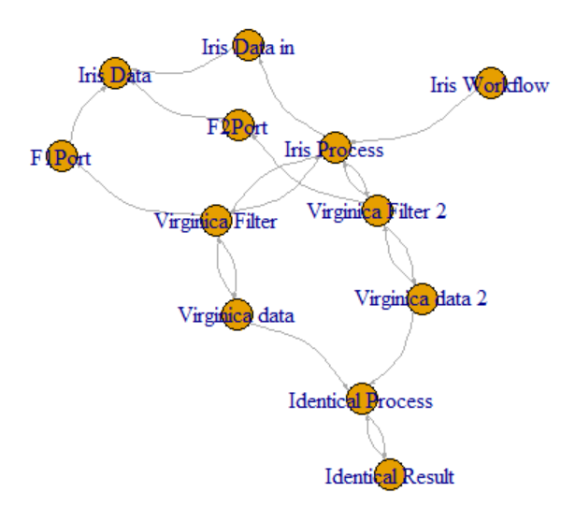
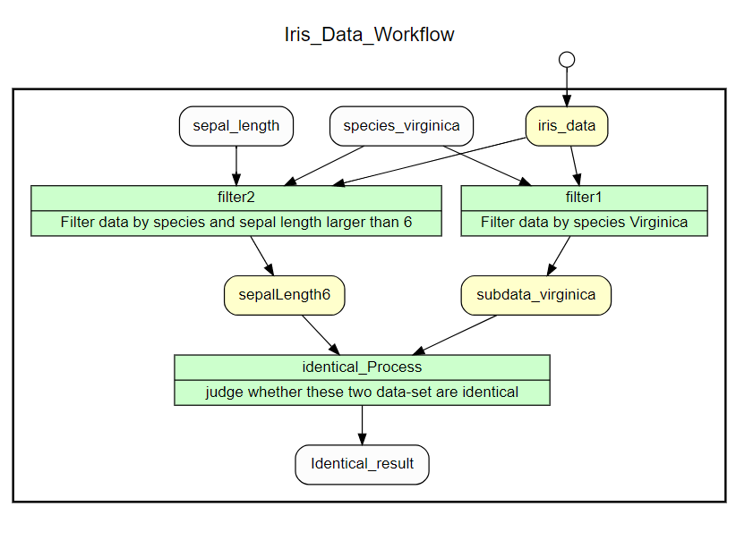
Similarity: Output RDF Diagram

Slide 7
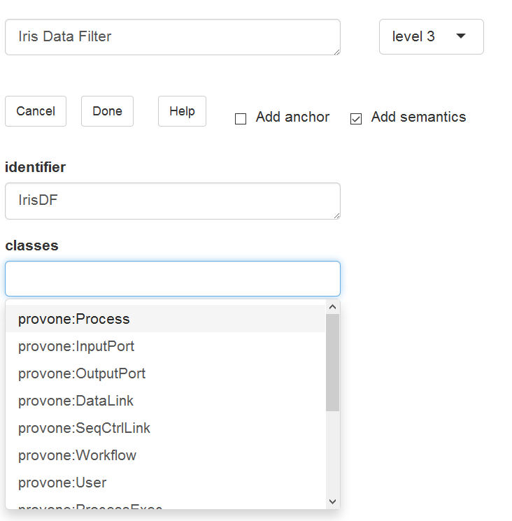
Advantage of ‘Strcode’ R extension
A user-friendly UI can help users add annotations.
Finish everything in R.

Slide 8
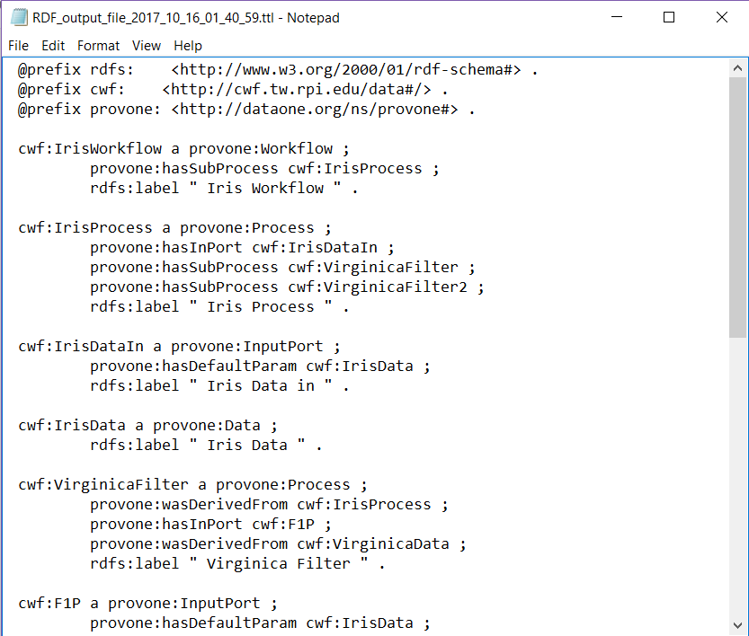
Advantage of ‘Strcode’ R extension
Generate a RDF file in standard RDF format which can be used in a larger graph(also the main task for my project)
Maybe support more types of RDF format in the future...

Slide 9
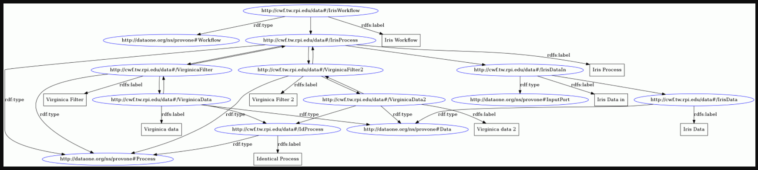
Advantage of ‘Strcode’ R extension
By using the standard RDF file, the result can be explain by other tools.
A graph generate by ‘easy RDF converter’: http://www.easyrdf.org/converter

Slide 10
Advantage of YesWorkflow
Easy learning and understanding manually type-in code.
Well-defiened Workflow graph.
Colored RDF diagram.
Supported by different programing language
Easy to query
Much more stable...

Slide 11
Thanks
Questions?

